Slide 1

PYTHON
FUNCTIONS

Slide 2

OBJECTIVES
About Functions.
Defining Functions.
Calling Functions.
Number of Arguments.

Slide 3
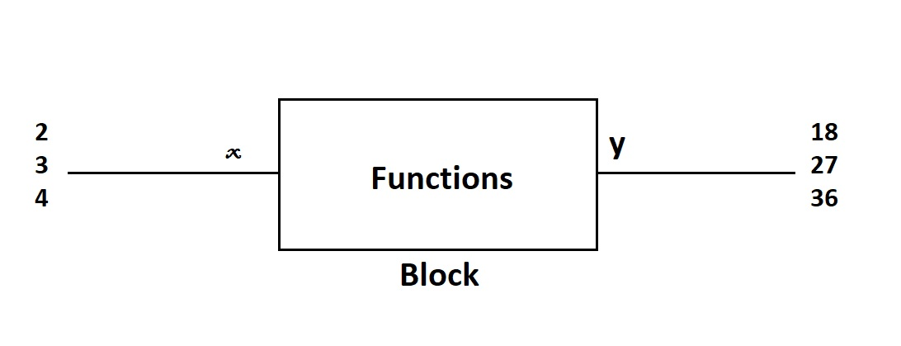
FUNCTIONS
A functions is like a block that takes some input, perform some operations on input, and give back something new.

Slide 4
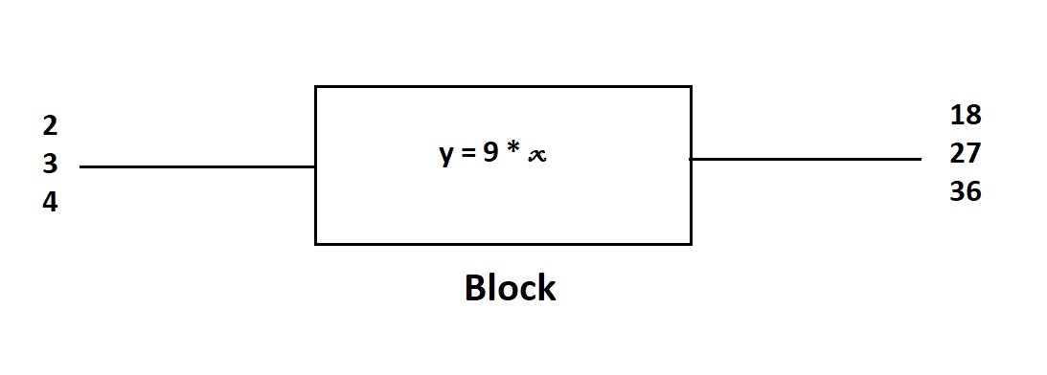

Slide 5
CREATING A FUNCTION
SYNTAX:
def function_name ( parameter_1, parameter_2 , …….. ) :
Operations to perform upon the parameters.

Slide 6
CALLING A FUNCTION :
def sum_of_three ( a , b , c ) :
d = a + b + c
return d
def sum_of_three ( 5 , 6 , 11)
Output : 21

Slide 7
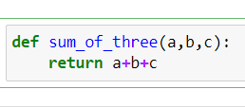

Number of Arguments :
A function must be called with the no of arguments we used during definition of function.
Defining the Function
Calling the function

Slide 8
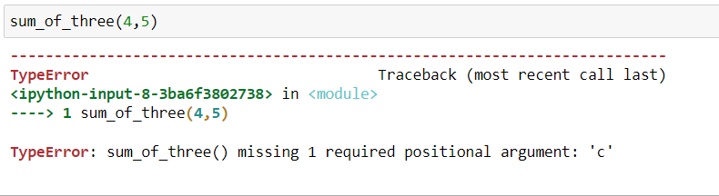
NUMBER OF ARGUMENTS:

Slide 9
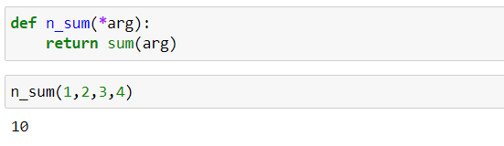
ARBITRARY KEYWORD(*arg):
When we don’t know how many parameters are going to be passed in function during its definition, then we use * sign before single argument. This single argument becomes the variable in which the tuple of passed arguments are stored during function calling:

Slide 10
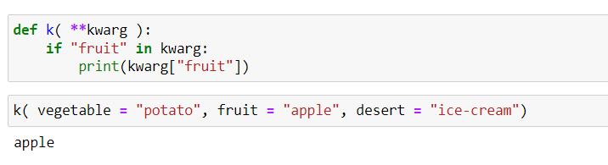
KEYWORD ARGUMENTS(**kwarg):
You can also send arguments with the key = value syntax, while *arg convert the passed argument into tuple, the **kwarg becomes the dictionary of passed key- value pairs during the function definition.

Slide 11
KEYWORD ARGUMENT(**kwarg)
The ** sign are used to denote the arbitrary keyword arguments, the Kwarg creates the dictionary of the passed key-value pair argument:

Slide 12

SUMMARY
A functions is like a block that takes some input, perform some operations on input, and give back something new.
You can use arbitrary arguments when no of arguments to be passed are not known.
Notes:
https://www.w3schools.com/python/python_ref_string.asp

